Slide 1
In the name of Allah, most gracious and merciful
Object Oriented Concepts &Design with Lab
Relation
Interface

Slide 2
What is interface
Interface is very similar to class. Interfaces define properties, methods, and events, which are the members of the interface. Interfaces contain only the declaration of the members. It is the responsibility of the deriving class to define the members.

Slide 3
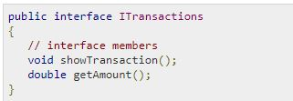
Declaring Interfaces
Interfaces are declared using the interface keyword. It is similar to class declaration. Interface statements are public by default. Following is an example of an interface declaration:

Slide 4
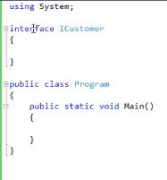
Interface names are prefixed with capital I

Slide 5
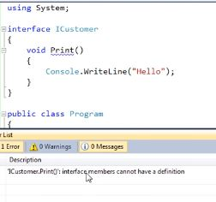
Implementation for a interface member will cause compile time error.

Slide 6
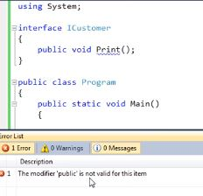
Interface members are public by default and they don’t allow any explicit access modifiers

Slide 7
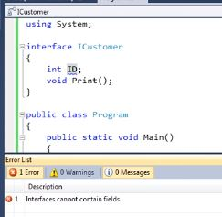
Interface can not contain fields

Slide 8
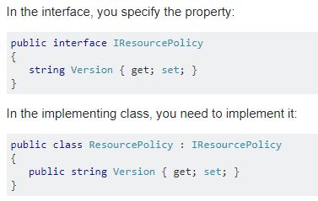
How to implement a property in an interface

Slide 9
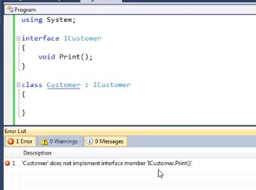
If a class inherits from an interface it must provide implementation for all interface member. Otherwise we get a compiler error.

Slide 10
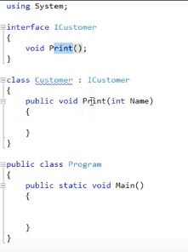
Pass the same parameter as interface

Slide 11
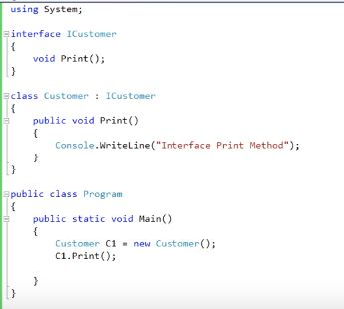
A fully implemented interface

Slide 12
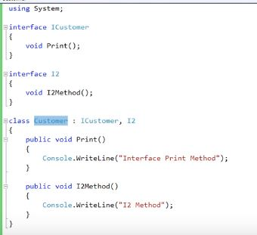
A class can inherit more than one interface where a class can not inherit more than one class at the same time

Slide 13
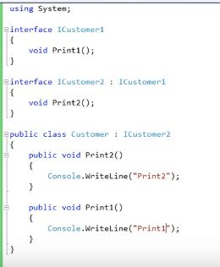
Interfaces can inherit other interfaces. A class that inherit this interface must provide implementation for all interface member in the entire interface inheritance chain

Slide 14
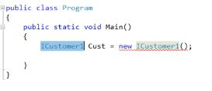
We can not create instance of an interface

Slide 15
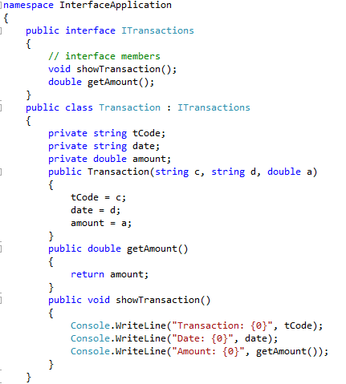

Slide 16
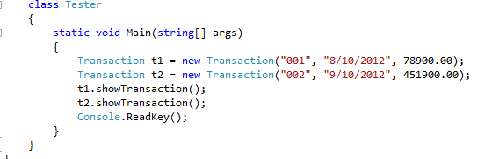

Slide 17
Interface : Example
Circle, rectangle – these 2D shapes have a job have to be done which is calculating the area of those shapes, again cone, cylinder – these 3D shapes will calculate the area of shapes and the volume of the shapes also.
On the above situation, implement the concept of interface.

Slide 18
Interface : Example
In Ab Office, there are managers, stuffs and cleaners who have attributes like id and name. For all employees of that company monthly salary must be calculated. For salary calculation consider that manager, stuff and cleaner get daily 500, 300, 100 taka respectively.
Design proper classes with implementing inheritance. [Interface must be implemented]

Slide 19
Relation between objects
Is-A-relation (inheritance)
Has-A-relation (object composition)

Slide 20
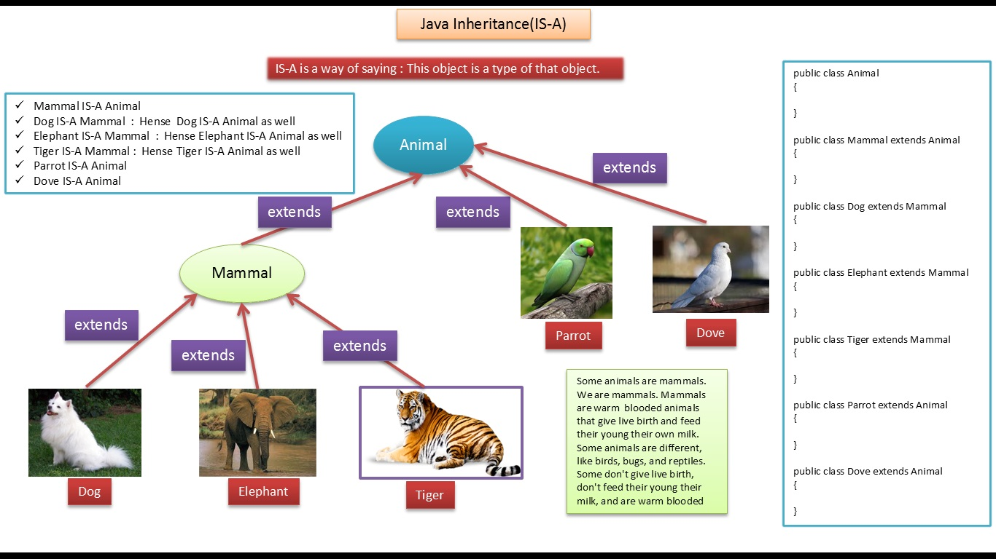

Slide 21
Is-A-relation
This refers to inheritance or implementation.
Main advantage is code reusability.

Slide 22
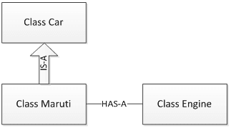
Has-a-relation

Slide 23
Has-A-relation
Has-A means an instance of one class “has a” reference to an instance of another class or another instance of same class.
It is also known as “composition” or “aggregation”.
There is no specific keyword to implement HAS-A relationship but mostly we are depended upon “new” keyword.

Slide 24
Has-A-relation
Composition(HAS-A) simply mean the use of instance variables that are references to other objects. For example Maruti has Engine, or House has Bathroom.

Slide 25
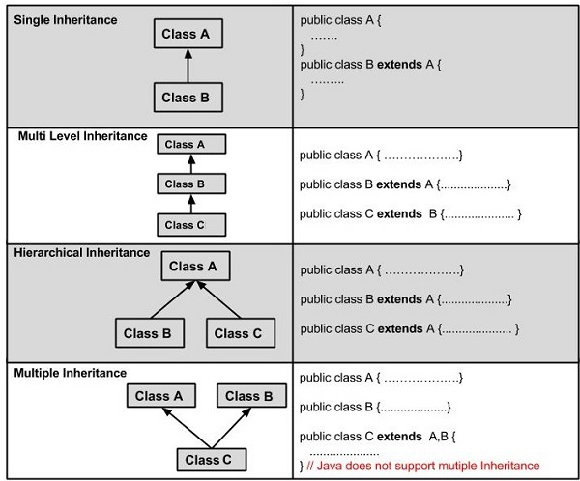

Slide 26
Multiple Inheritance
Multiple inheritance : using interface

